Slide 1
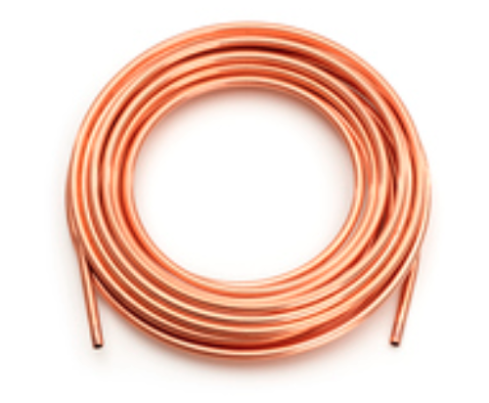
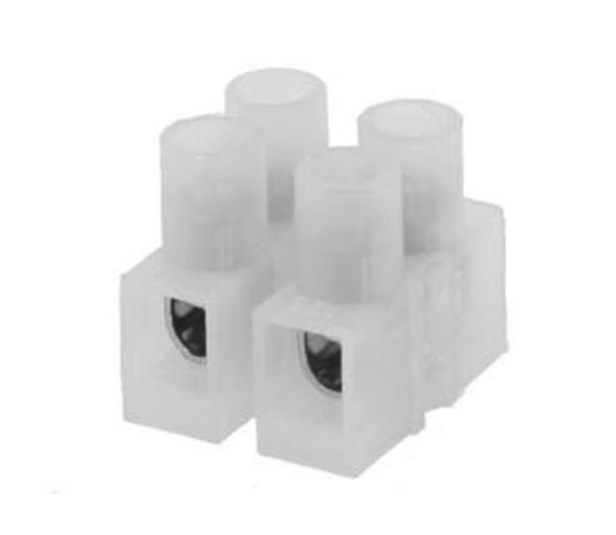
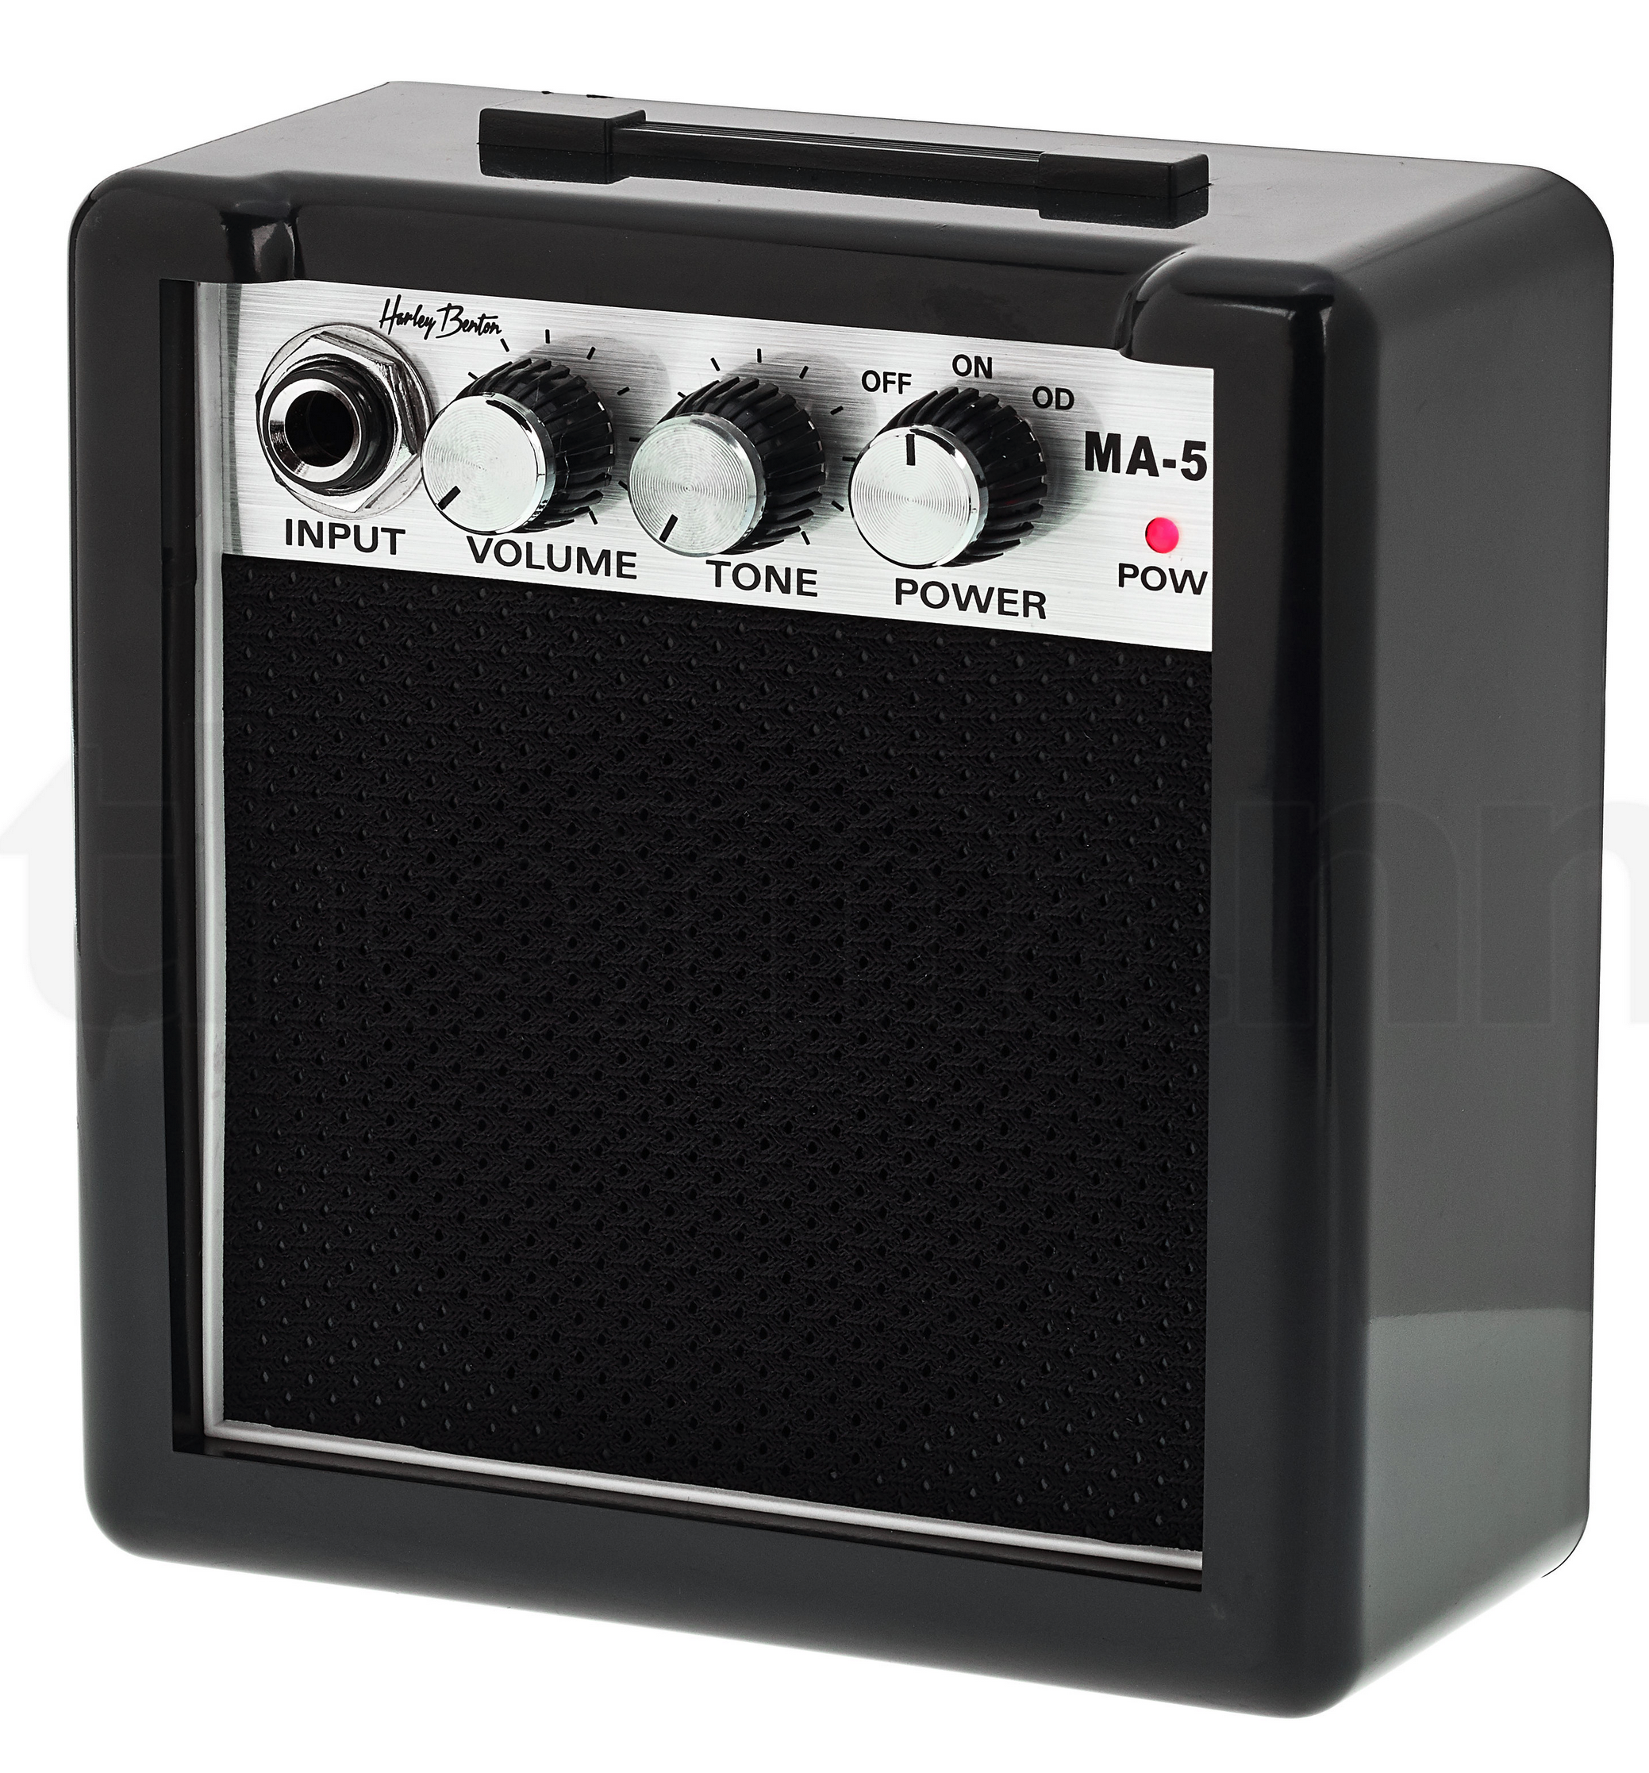
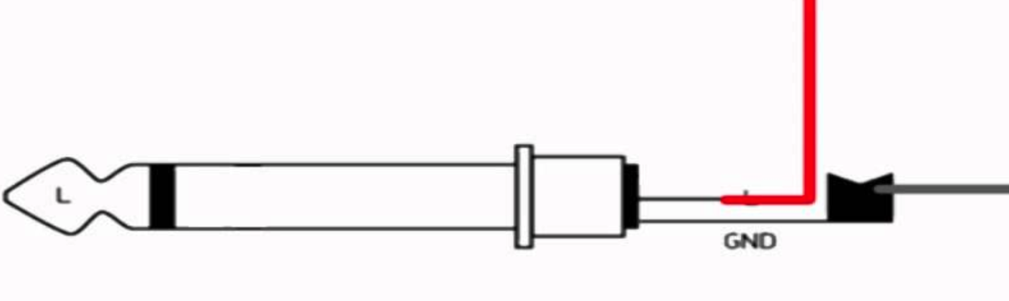


Kit 1:
electromagnetic sounds
coil
sleeve = GND
wire connector
tip = SIGNAL
Make a coil from lacquered copper wire
Play with amount of windings
Burn lacquer off the ends with a lighter for connection
Also try: making coil with e.g. copper tape?
Explore electric appliances

Slide 2
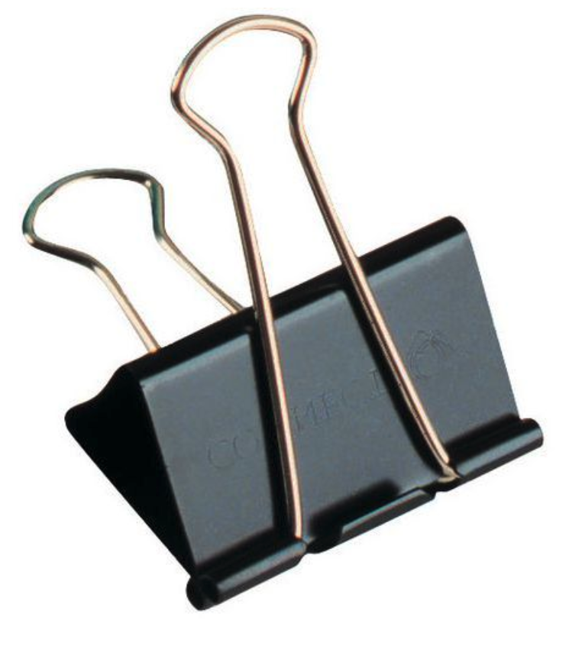
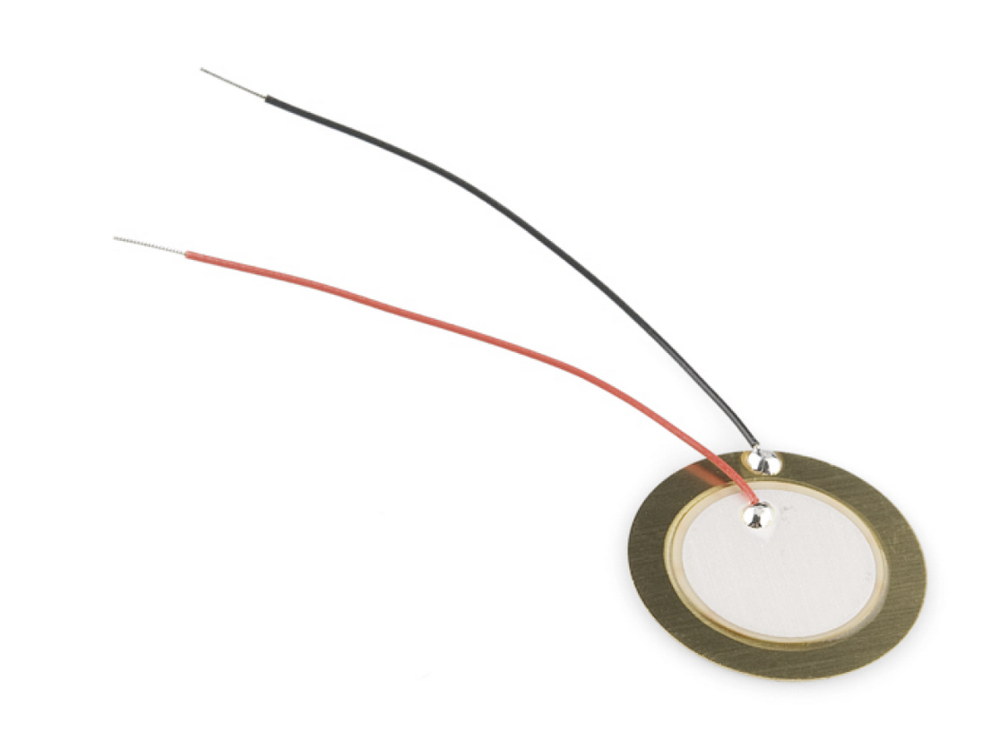
Kit 2:
Pressure sounds
piezo transducer
sleeve = GND
wire connector
tip = SIGNAL
Press, bend, knock on the piezo to create a signal
Mount on other materials to amplify vibrations
Basically a pick-up mic
Handy: foldback clips, screws, wire connectors for mounting/connecting
Fun: tension different wires on a sounding board and amplify w piezo

Slide 3
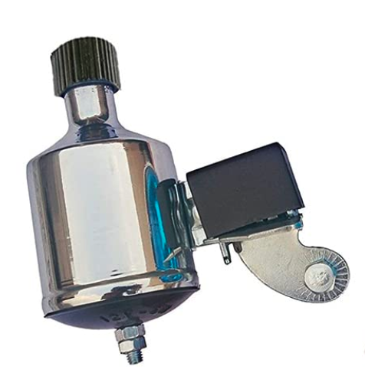



Kit 3:
Dynamo sounds
sleeve = GND
tip = SIGNAL
If needed: use alligator clip to connect to dynamo
Try out different DC motors
Run across different surfaces
Make attachments for turning knob

Slide 4
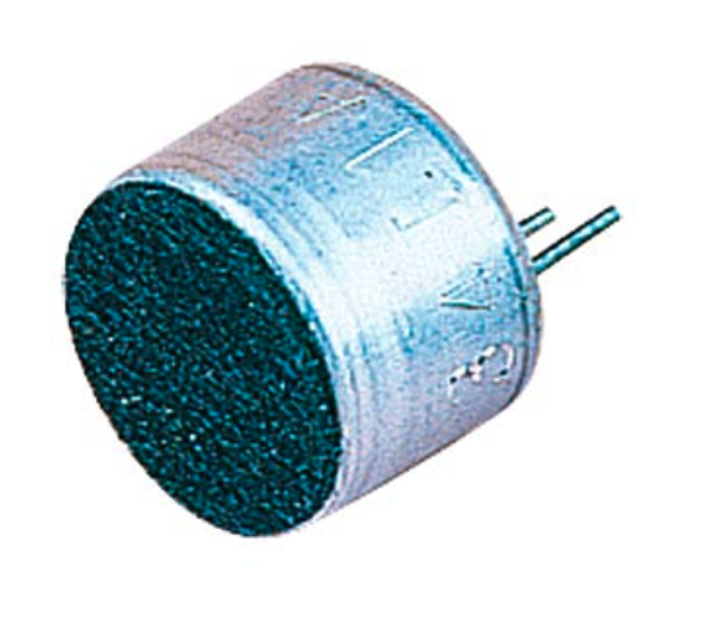
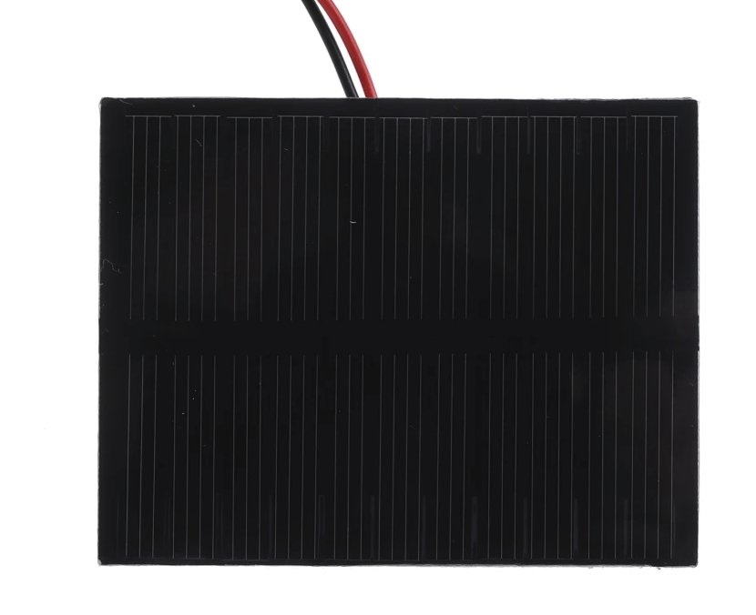
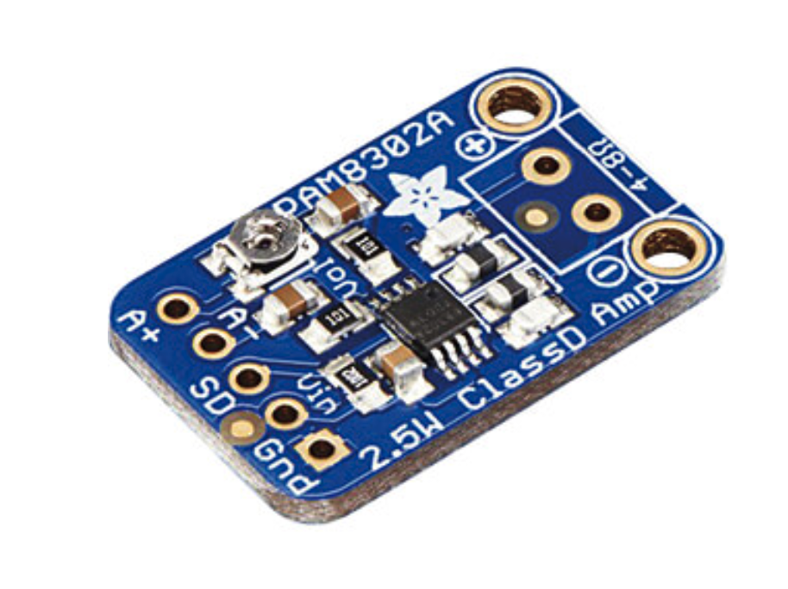
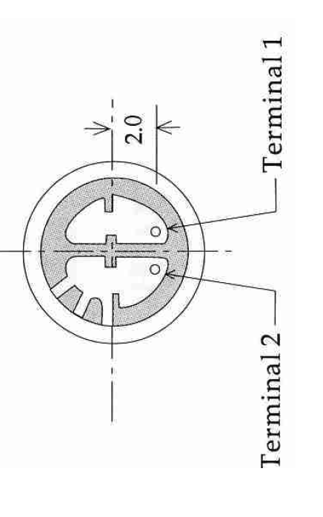








Kit 5:
Solar sounds
Play with light/shadow
Check polarity of solar cell and mic
Mic needs some re-enforcement (e.g. mount on cardboard)
GND
SIGNAL

